Slide 1
Market Update, 3/22
Quant Lab
Israel Diego

Slide 2
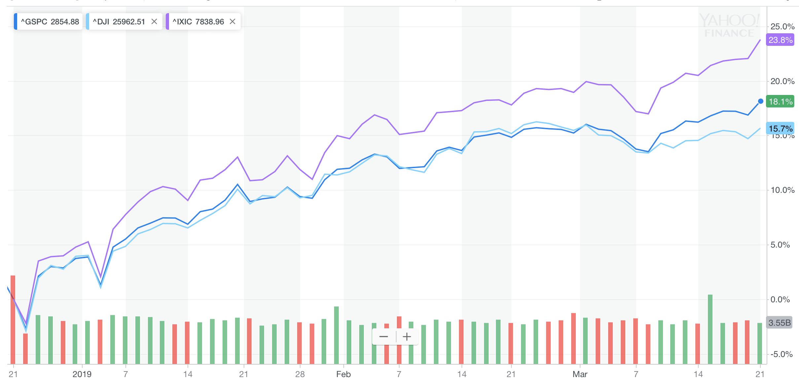
What happened this week?

Slide 3
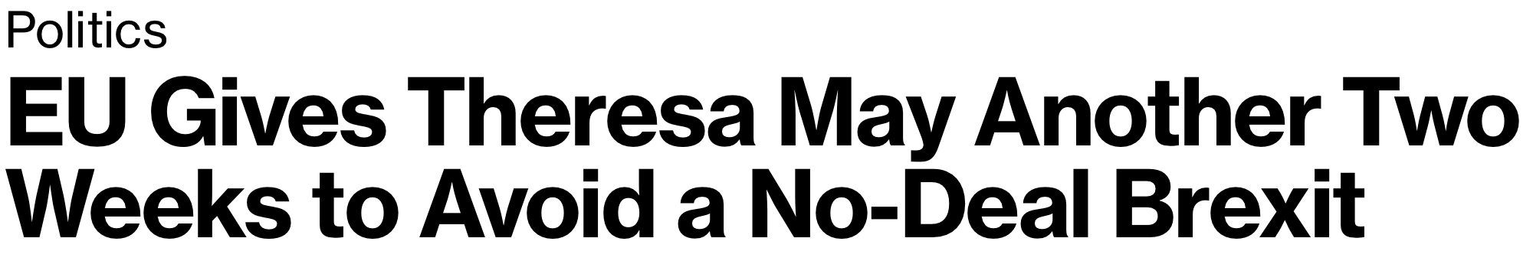
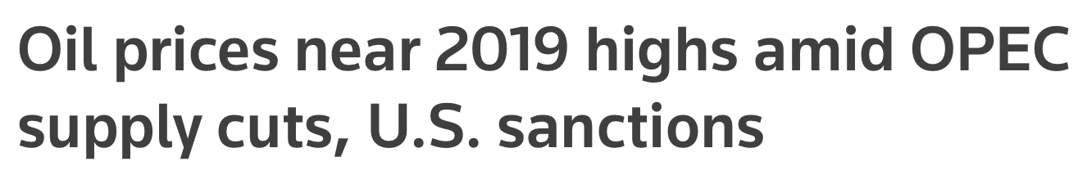
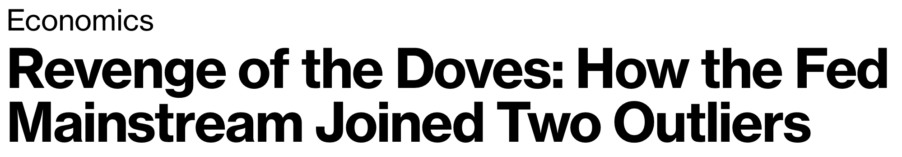

Slide 4
News Links
EU gets another Two weeks to avoid No-Deal Brexit
Oil Prices Rising
Fed is Dovish

Slide 5
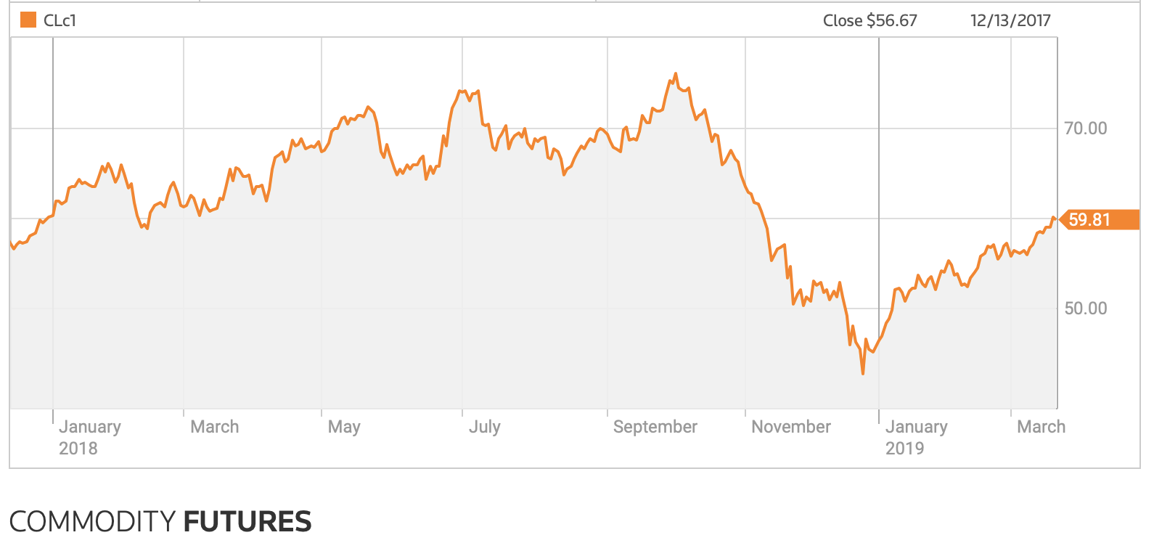
Source: Thomson Reuters

